Slide 1
Simstack II Onboarding
Plans & Status

Slide 2
Onboarding Plan
Onboarding in the PMD PyIron Instance & Onboarding Simstack Instance
Participants must register with both
https://github.com/simstack/simstack-onboarding
12 steps to installation (15 minutes for experts -> move to image)
UI Intro with preconfigured WF (15 minutes clickfest) -> Presentation
Write & Run a trivial workflow (~ 20 minutes)
ML Workflows (30 minutes +)
Outlook (things not covered)
Aggregation
Advanced Datasets
Artifacts
Semantics

Slide 3
UI Intro
Submit Jobs
Status?
Results ?
Making Plots
Datasets
Health
Configuration

Slide 4

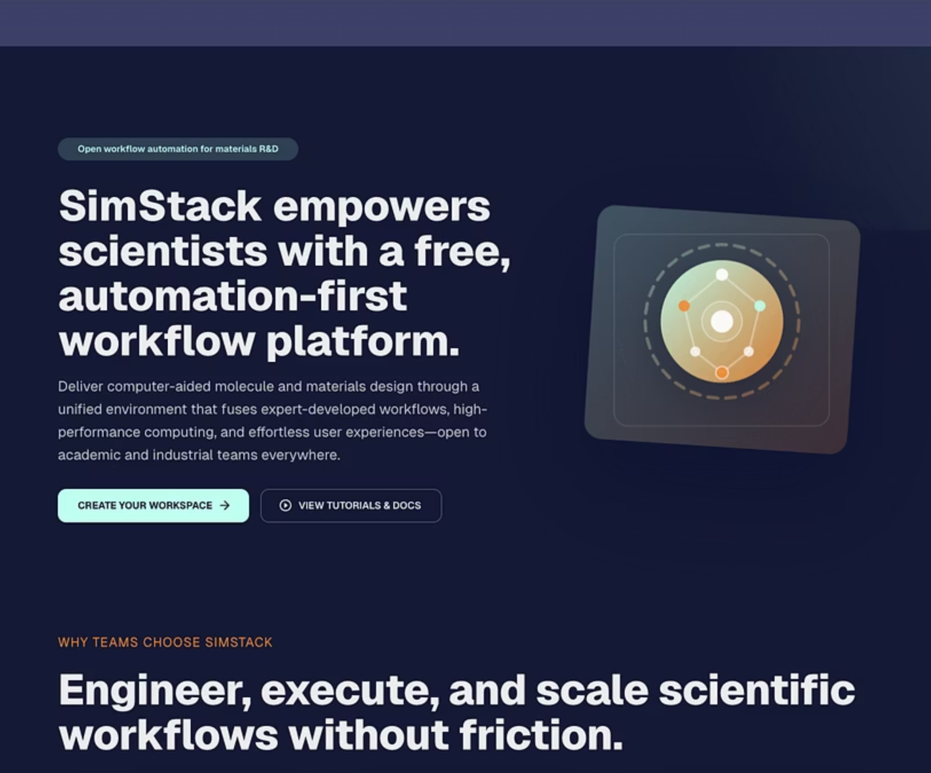
Python Workflows & Experiment Tracking
We need better (human accessible) tools to analyze …..
Experiment Tracker
(for machine learning)
Python Worklow
Artifacts (Human Readable Data)

Slide 5
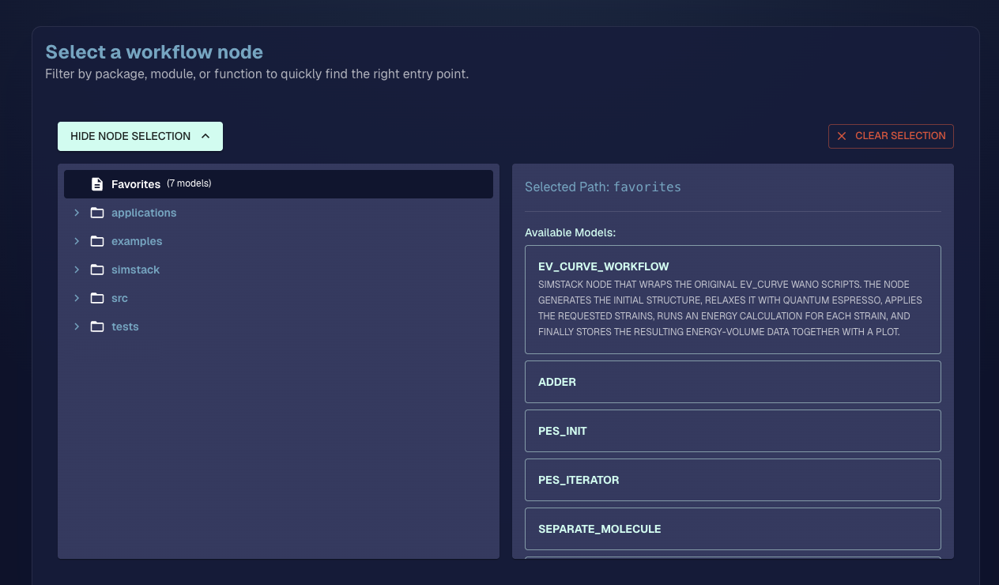

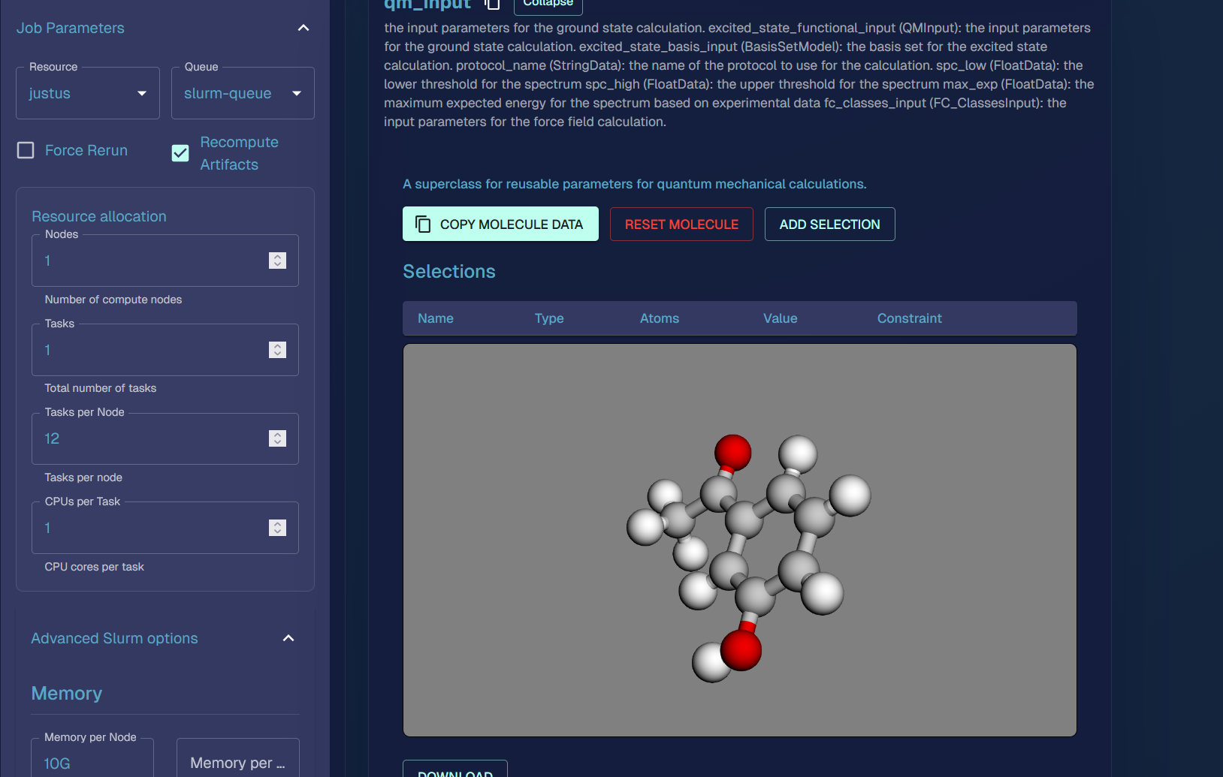
Architecture
UI Elements
Python Code
Graphical User Ínterface
Workflow Generation
Workflow Execution
Submitting the WF Run stores the top node as „submitted“ in the DB
Artifacts
Data

Slide 6
Architecture
UI Elements
Python Code
Graphical User Înterface
Workflow Generation
Workflow Execution
Artifacts
Data

Slide 7

Architecture
Workflows are executed by runners on remote or local resources
You need a „runner“ on the remote resource (JypterLab) to execute the WF
Each runner has a resource name (use „local“)
The runner reads one job at a time from the DB, executes the code and possible generates 100.000 new entries in the DB
UI Elements
Python Code
Graphical User Ínterface
Workflow Generation
Workflow Execution
Artifacts
Data

Slide 8
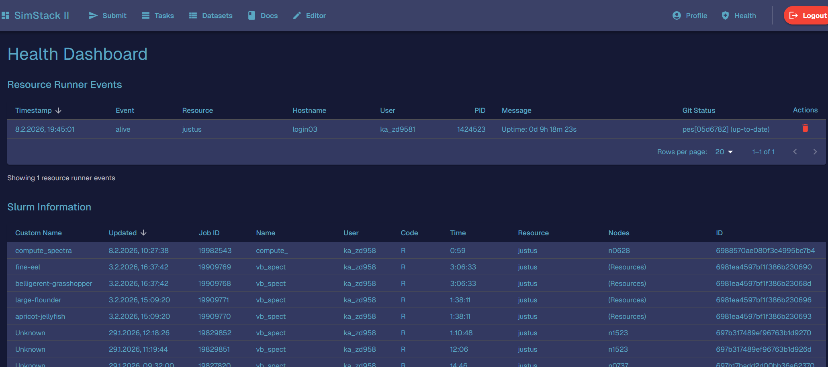
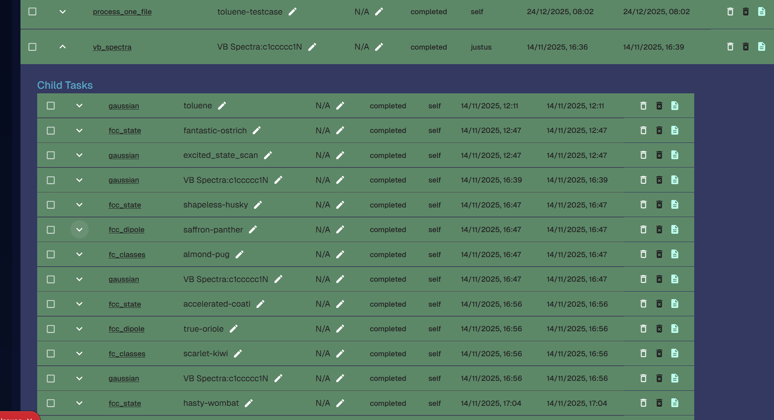
Architecture
UI Elements
Python Code
Graphical User Ínterface
Workflow Generation
Workflow Execution
Artifacts
Data

Slide 9
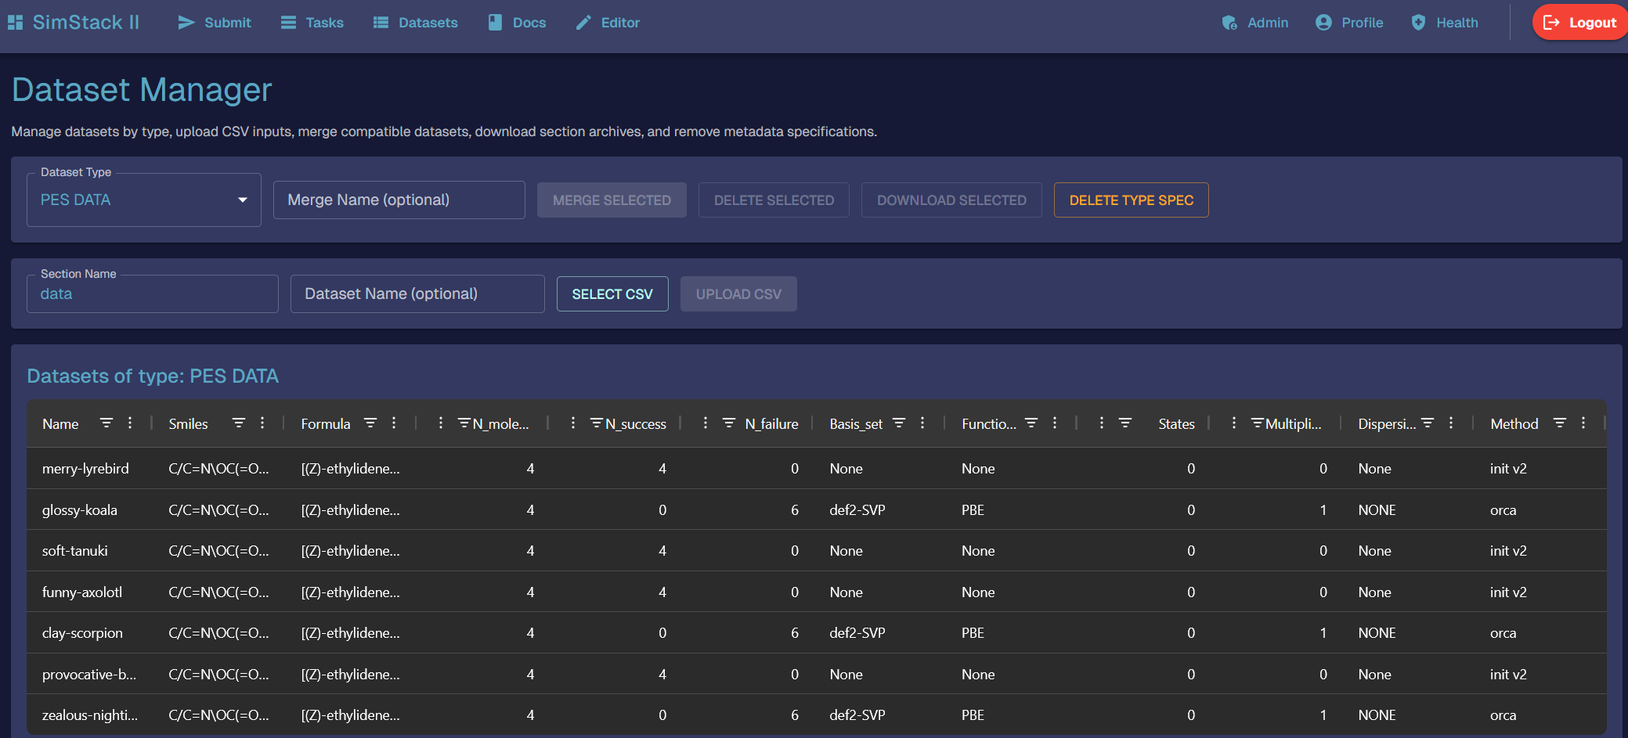
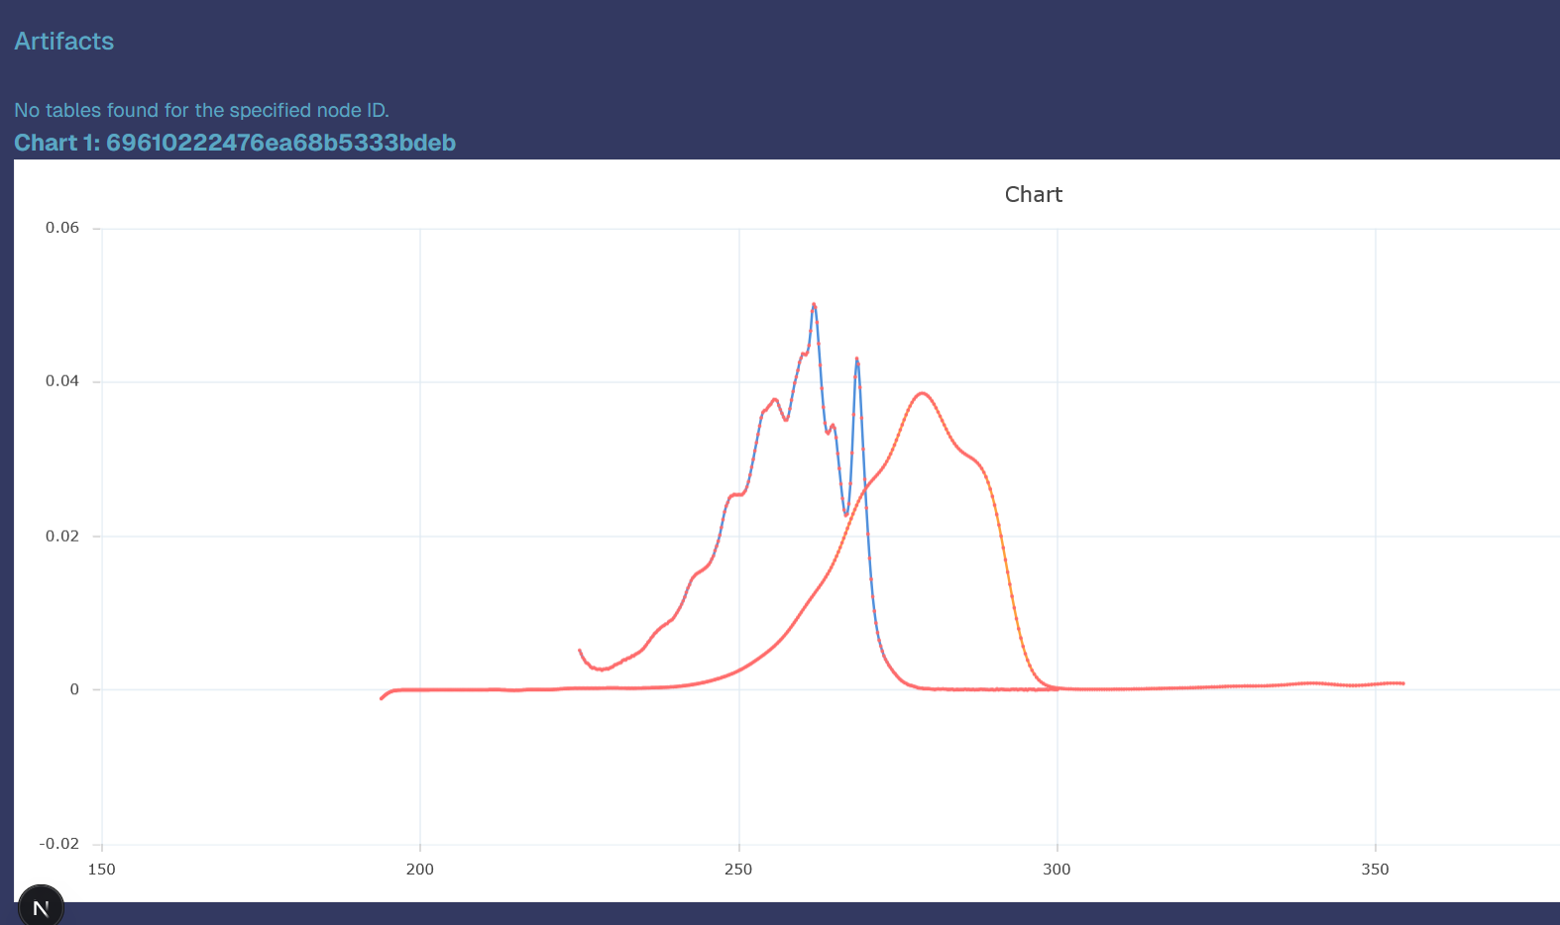
You can inspect the results in graphical and tabular form
If you need extra analysis you can make this after the run

Slide 10
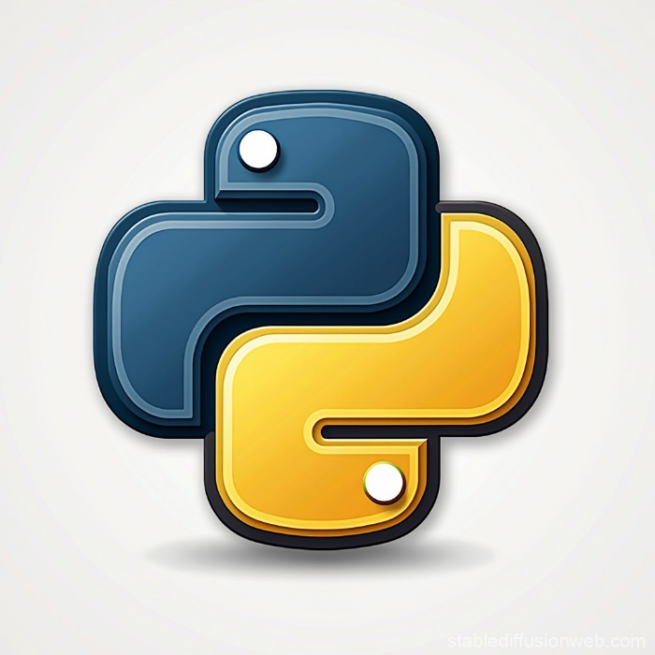
Python Side
How does your python program interact with the DB:
All your function arguments and retrurn types are Odmantic Models
Odmantic is a python Mongoi DB wrapper
Odmantic is built on top of pydantic
Your code does (typically) not interact with the DB
How does the UI know your data types and nodes ?
Utility function create_model_table
Utility function create_node_table
The UI is auto-generated
How does your runner know your code ?
Periodic git pull (also auto-builds the tables)

Slide 11
Architecture
@node def my_function(arg1: Model1,
arg2: Model2, ….) -> SimstackResult
UI Elements
decorator transforming function to workflow
Python Code
Graphical User Ínterface
Workflow Generation
Workflow Execution
database models
(pydantic)
written by developer
Artifacts
Data

Slide 12
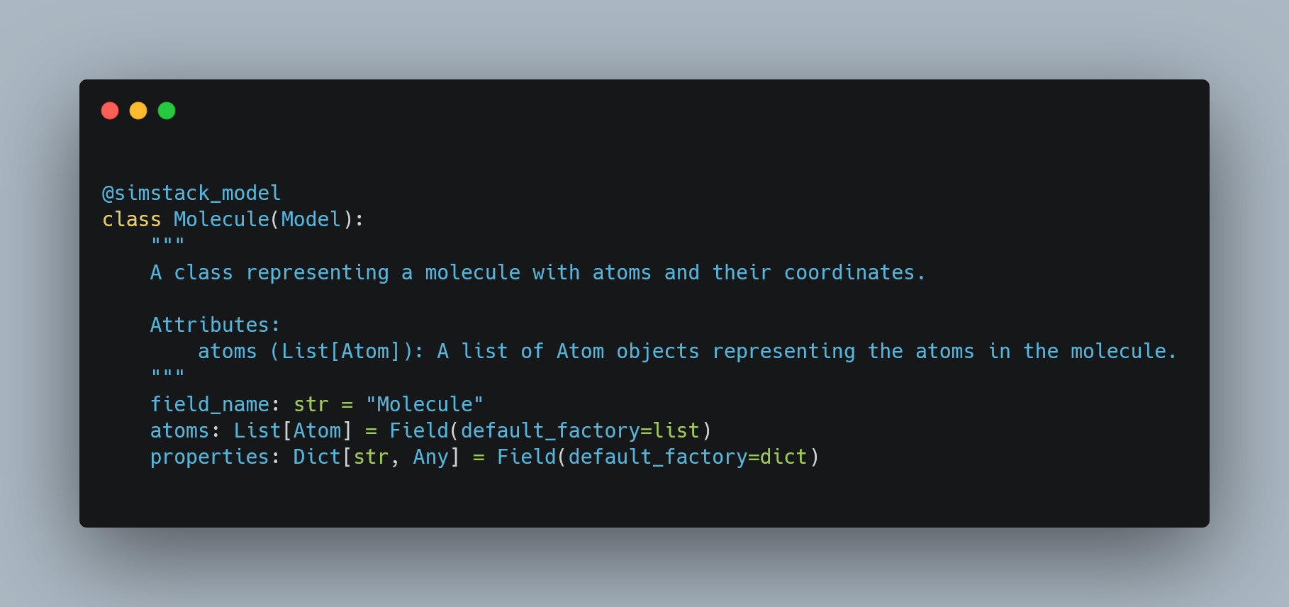
Model Example

Slide 13
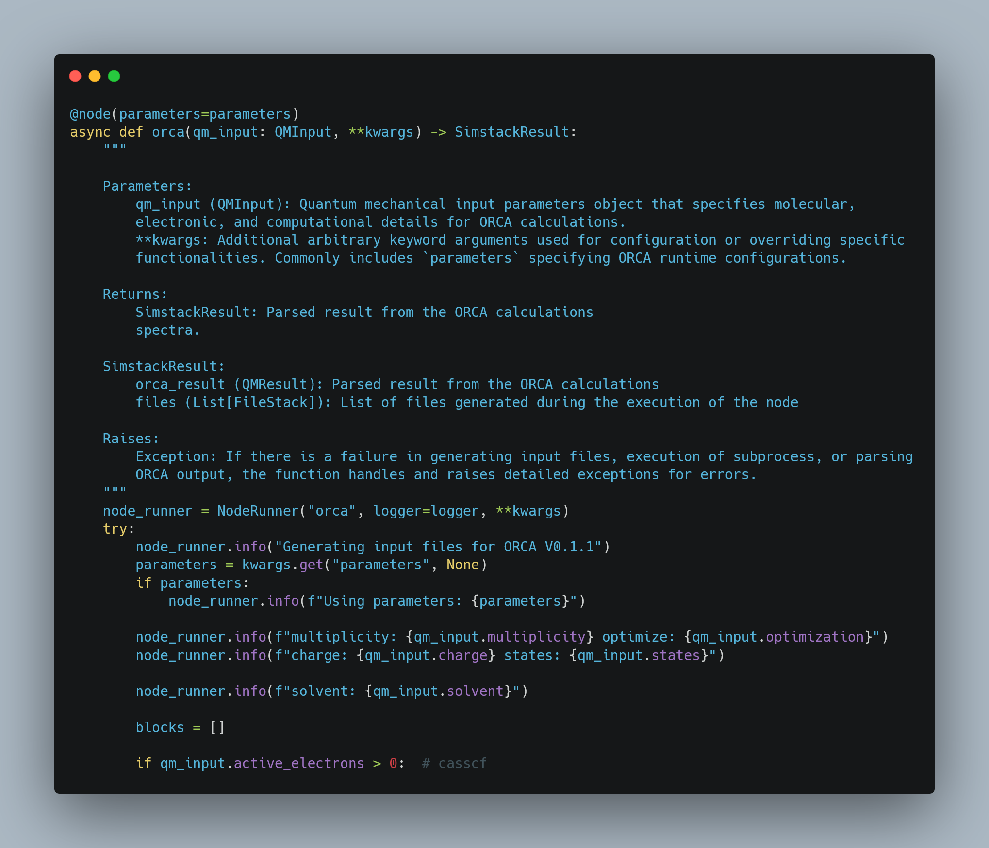
Node

